Slide 1
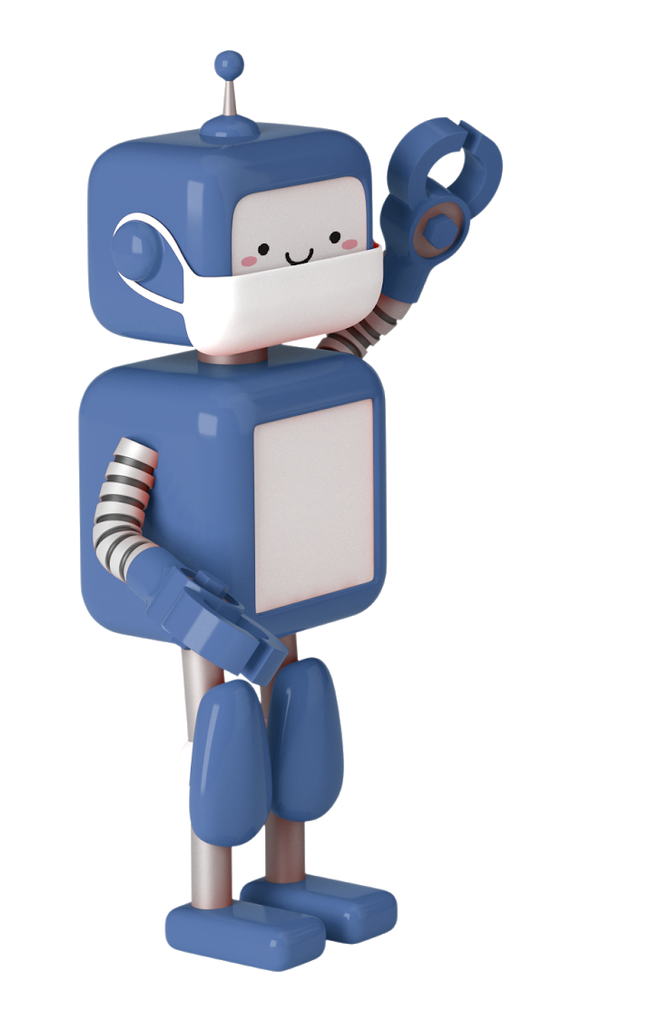

COZMO Presentation
GROUP 5

Slide 2
Group Members
Shi Min
Charmaine
Sherryan
Facial Recognition + Greeting + Display Shapes
Avoid Cubes + Alarm
Pyramid Stacking + Passing of cubes
Shina
Kimberly
Story Time
Happy Pill Generator + Compliment Generator

Slide 3

01
Charmaine
Cozmo is able to detect all 3 cubes, celebrates when it detects each cubes and avoids all 3 cubes that have been placed. After avoiding all 3 cubes, Cozmo will celebrate.

Slide 4

Avoid Cubes

Slide 5
Cozmo Alarm
Cozmo is also programmed to wake the programmer up after a specific hours/minutes/seconds the programmer wishes. Cozmo will wake programmer up by playing a fire alarm sound and say “wake up!”. if the programmer wishes to snooze, they have to pick up Cozmo and Cozmo will acknowledge and wake the programmer after 5 minutes. Once the programmer taps cube number 1, it will turn from green to black and Cozmo will acknowledge that the programmer has woken up so it will wish the programmer “Good Morning!”

Slide 6
Cozmo Alarm

Slide 7
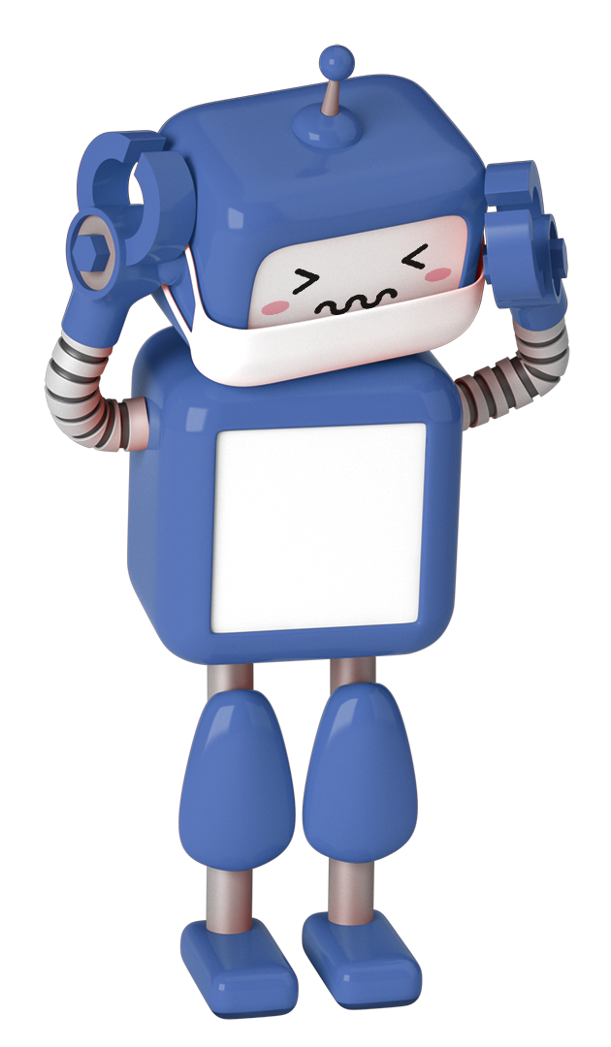
02
Kimberly

Slide 8
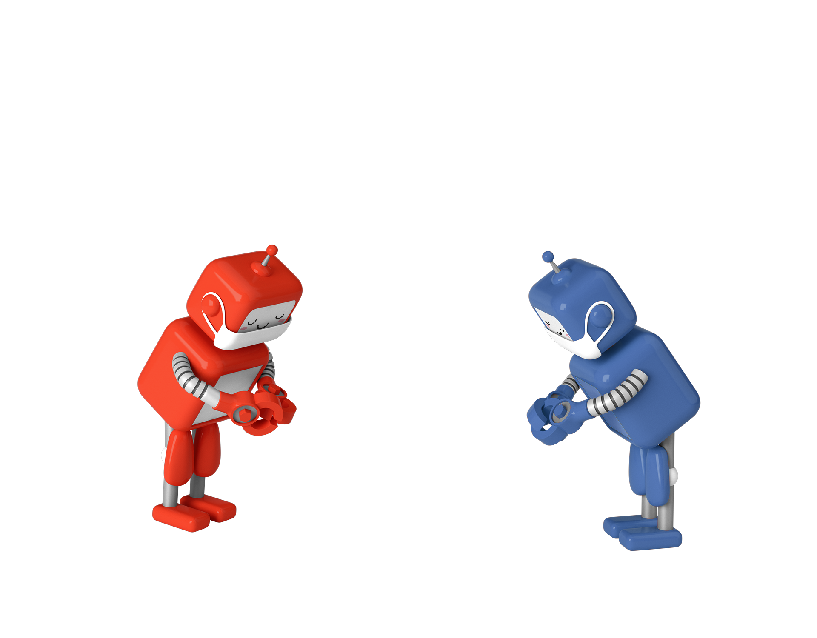
KIMBERLY
Happy Pill Generator
Compliment Generator
Cozmo reacts to your facial expressions + Positive Statement=Boosting one’s mood
Cozmo compliments an individual with different positive statements cheer ones up

Slide 9
Happy Pill Generator

Slide 10
Compliment Generator

Slide 11
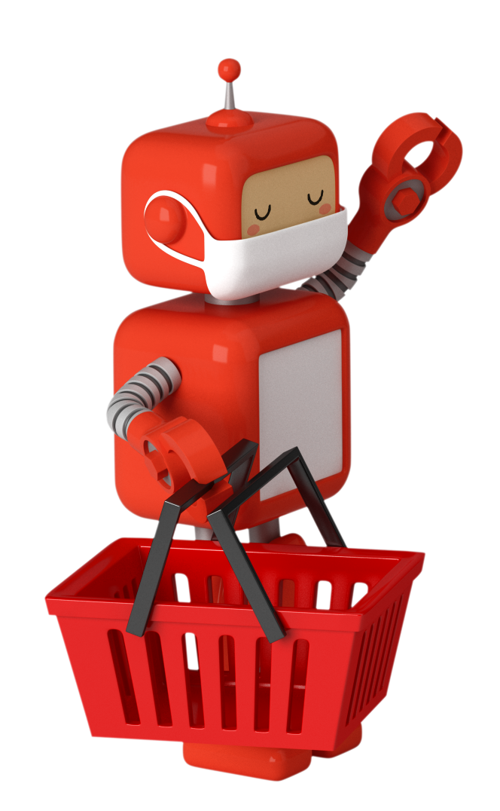
03
Shina
In this project, Rusty a futuristic robot had been programmed to carry cubes for centuries.

Slide 12
One day, it sets out to search for its meaning of existence. In the process of discovery, Rusty realized that the very crux of its issue is the absence of its developer

Slide 13
Codes in Rusty’s story
01
03
02
04
Carry cube
Sing
Dance
Facial Recognition
Designated cube to a pre-programmed area (Dumpster)
Sings Do-Re-Mi
Without music
Viewing the storyline voice over allowing to enter the robot’s perspective

Slide 15
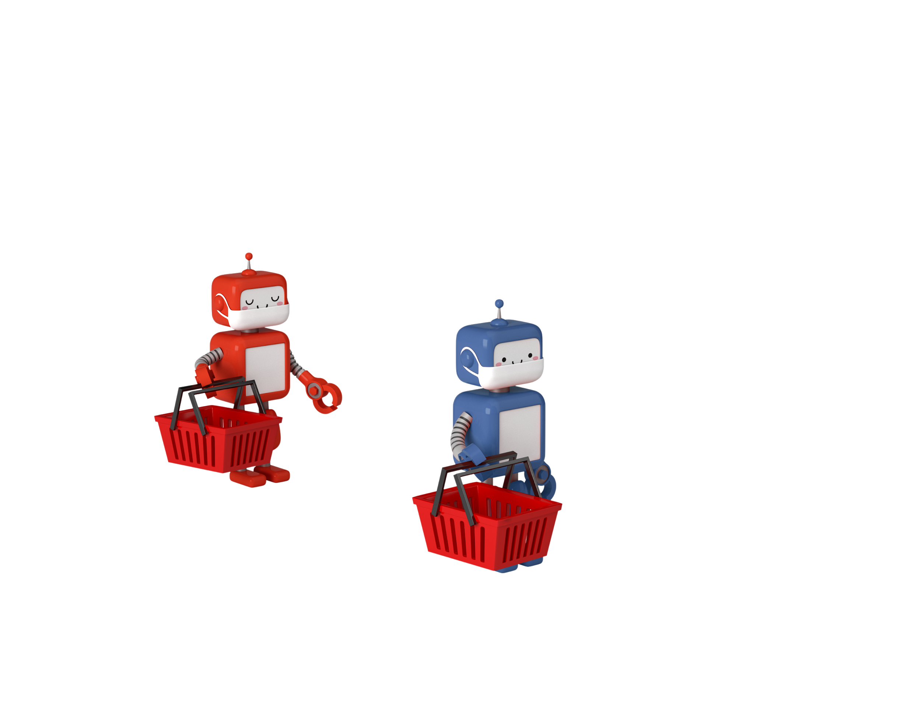
04
Shi Min
Cozmo will gather all three cube and try form a shape lighting all the cubes at the end. Afterwards, cozmo will proceed to scan for person and say a normal greeting before displaying shapes and text on his screen

Slide 17
05
Sherryan

Slide 18
Sherryan
Stack a Pyramid
Passes all 3 cubes
Cozmo will find 2 cubes, aligning them side by side, then the last cube will be stacked, completing the pyramid formation.
Each time Cozmo picks up a cube, it will light up indicating that the cube has already been passed.

Slide 19
Stack a Pyramid

Slide 20
Passes all 3 cubes

Slide 21
-THE END-

